Slide 1




NEXT GEN EMPLOYABILITY PROGRAM
Creating a future-ready workforce
Team Members
College Name
Student Name : P. Priya Mahalakshmi
Student ID : au951221104033
JP College Of Engineering

Slide 2

CAPSTONE PROJECT SHOWCASE
Project Title
Voting Web Application using Django Framework
Abstract | Problem Statement | Project Overview | Proposed Solution | Technology Used | Modelling & Results | Conclusion

Slide 3
Abstract
This project entails the development of a web application utilizing Django, a Python-based web framework, to facilitate online voting processes. The application will offer a user-friendly interface allowing voters to securely cast their votes for various elections or polls. Key functionalities will include user authentication, candidate or option selection, and result tabulation. Utilizing Django's robust features such as built-in user management, form handling, and database integration, the application will ensure data integrity, security, and scalability. Through careful design and implementation, the voting web application will provide an accessible and efficient platform for democratic participation while adhering to best practices in web development and security standards.
Source :

Slide 4
Problem Statement
The current lack of an accessible and secure online platform for voting poses challenges to democratic processes. Traditional methods are often cumbersome, prone to errors, and limited in accessibility. To address these issues, the development of a user-friendly and secure web application using Django is necessary. This application aims to provide a convenient and reliable platform for voters to cast their ballots remotely while ensuring the integrity and confidentiality of the voting process.
Source :

Slide 5
Project Overview
Project Overview:
The voting web application using Django aims to create a straightforward online platform for users to participate in voting processes. Users will be able to log in, view available elections or polls, cast their votes, and view the results. The application will prioritize simplicity, ease of use, and security, ensuring a smooth voting experience for all users.
Project setup
App creation
Database models
Admin interfaces
User authentication
Poll creation
Voting and results display
Frond end design and URL routing
Testing and deployment

Slide 6
Proposed Solution
Develop a voting web application using Django framework. Users authenticate,
view available elections, cast votes, and view results. Administrators create elections
and manage candidates. Implement basic security measures, ensure a minimalist
interface for easy navigation.
Source :

Slide 7
Advantages:
Advantages of Django Framework for Voting Web Application:
1. Rapid Development: Django's built-in features and conventions enable fast development, allowing for quick deployment of the voting web application.
2. Scalability: Django's modular structure and scalability features make it suitable for handling increased traffic and accommodating future growth of the application.
3. Security: Django provides robust security features, including protection against common vulnerabilities such as CSRF attacks and SQL injection, ensuring the integrity and confidentiality of the voting process.
4. Built-in Authentication: Django offers a built-in user authentication system, simplifying the implementation of user registration, login, and account management functionalities.
Source :

Slide 8
Disadvantages
Learning curve: Django has a learning curve, especially for beginners or developers who are not familiar with Python or MVC (Model-View-Controller) frameworks. It may take time for developers to become proficient in Django's concepts and conventions.
Overhead: Django's batteries-included approach may lead to unnecessary overhead for simpler applications, potentially impacting performance.
Learning Curve: Django's extensive feature set and conventions may present a steep learning curve for developers who are new to the framework.
Limited Flexibility: While Django offers a lot of built-in functionality, it may be less flexible compared to micro-frameworks when it comes to customizing certain aspects of the application.
Deployment Complexity: Deploying Django applications can be more complex compared to simpler frameworks, especially for beginners, requiring additional configuration and setup.
Source :

Slide 9




Technology Used
Front-end
Back-end
Source :

Slide 10
Modelling & Results
In developing a voting application using Django, meticulous attention is directed towards both modeling the underlying data structure and effectively presenting the voting results to users.
Through Django's model system, the application's data architecture is meticulously crafted, typically featuring models like Question and Choice to represent the polls and available choices.
Once users have participated in the voting process, conveying the results to them becomes paramount.
Leveraging Django's templating system, the application dynamically generates HTML templates that vividly present the voting outcomes in an intuitive and visually engaging manner.
Furthermore, the application may utilize charting libraries or custom visualization techniques to elucidate the distribution of votes across different options, offering users valuable insights into the voting process's outcome.
Source :

Slide 11
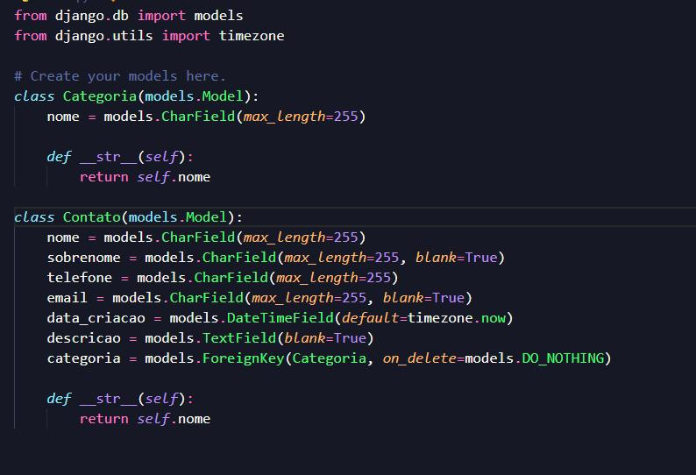
Homepage

Slide 12
About-Us-Page
1.Credibility: The "About Us" page establishes credibility by providing informationabout the organization's history, mission, and team members .
2.Mission and Values: It communicates the organization's mission, values, and objectivesin promoting democratic participation and decision-making.
3. Community Engagement: The page showcases the organization's commitment tocommunity engagement and empowerment through the voting process, inspiring active participation.
4. Contact Information: Users can easily reach out with questions, feedback, or inquiriesabout the voting application through the contact information provided on the page.

Slide 13
Service-Page
Header Section
Introduction section
User Services
Administrator Services
Organizational Services
Technical Services
Consulting Services
Call to Action Services

Slide 14
Departments-Page
Header Section
● Introduction Section
● Department Listings
● Department Details
● Key Personnel
● Collaboration Opportunities
● Footer Section

Slide 15
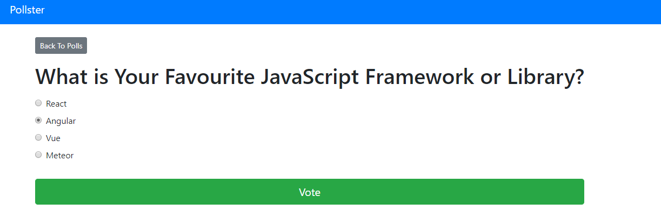
Blog-Page

Slide 16
Future Enhancements:
Utilize machine learning algorithms to analyze voting data, predict future trends, and provide personalized recommendations for users based on their voting history and preferences
Extend the voting application's reach by developing native mobile apps for iOS and Android platforms, offering a seamless and optimized experience for mobile users.
Explore integrating blockchain technology to enhance the transparency, security, and integrity of the voting process, ensuring that votes are immutable and tamper-proof.
Implement comprehensive reporting functionalities for administrators to generate detailed reports on voting patterns, demographics, and trends. This could include visualizations such as charts and graphs.

Slide 17
Conclusion
Using the Django framework for developing a voting web application offers numerous advantages, including rapid development, scalability, security, built-in authentication, admin interface, database abstraction, and strong community support. However, it's essential to consider potential disadvantages such as performance overhead, learning curve, deployment complexity, flexibility constraints, and dependencies.
Overall, Django provides a robust foundation for building secure and feature-rich voting web applications, especially for projects requiring rapid development and scalability. By leveraging Django's extensive features and community support, developers can create efficient and reliable voting platforms that meet the needs of users and administrators alike. However, careful consideration of project requirements and potential challenges is necessary to ensure a successful implementation.
Source :

Slide 18
Thank You!
Notes:
Thank You !!

